Slide 1
Luxury Housing Market Analysis Dashboard
Developed Using Python, SQL, and Power BI
Name: Ragini Boya
Course: Data Science – GUVI
Project Type: End-to-End Data Analytics Project

Slide 2
Project Problem Statement
The goal of this project is to analyze luxury housing market data to identify booking trends, builder performance, and buyer behavior.
This project helps:
• Identify high-performing builders
• Understand buyer preferences
• Analyze booking patterns
• Detect high-demand locations

Slide 3
Project Pipeline Architecture
Step 1: Data Collection
Step 2: Data Cleaning using Python
Step 3: Feature Engineering
Step 4: Load Data into SQL Database
Step 5: Query Data using SQL
Step 6: Create Dashboard using Power BI
Step 7: Generate Business Insights

Slide 4
Python Data Processing
Python was used for data cleaning and feature engineering.
Tasks Performed:
• Removed missing values
• Converted data types
• Created new calculated columns
• Prepared structured dataset
• Loaded cleaned data into SQL database

Slide 5
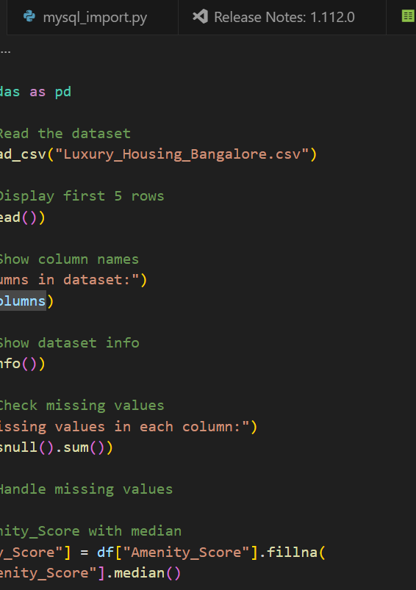
PICTURE OF DATA CLEANING IN PYTHON
Here I have written codes related to data cleaning, removing missing values, conversion of data types and created new calculated columns and prepared a cleaned and structured dataset and loaded it into SQL database.

Slide 6
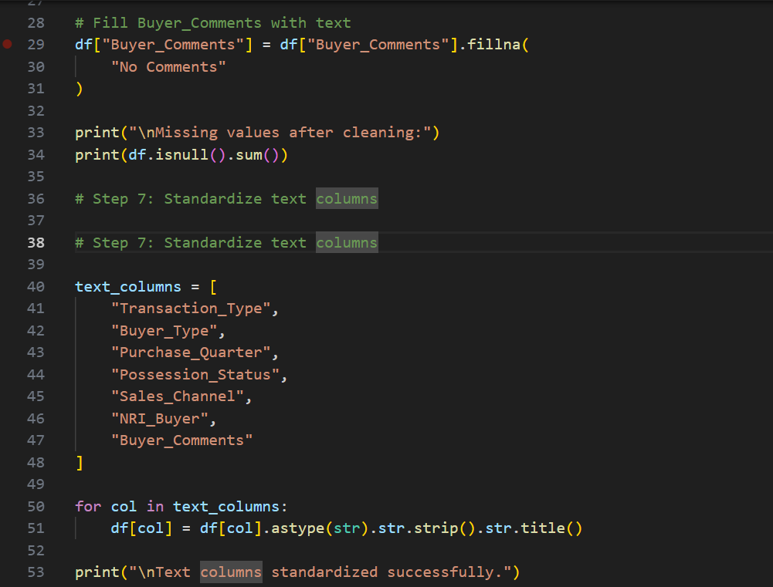
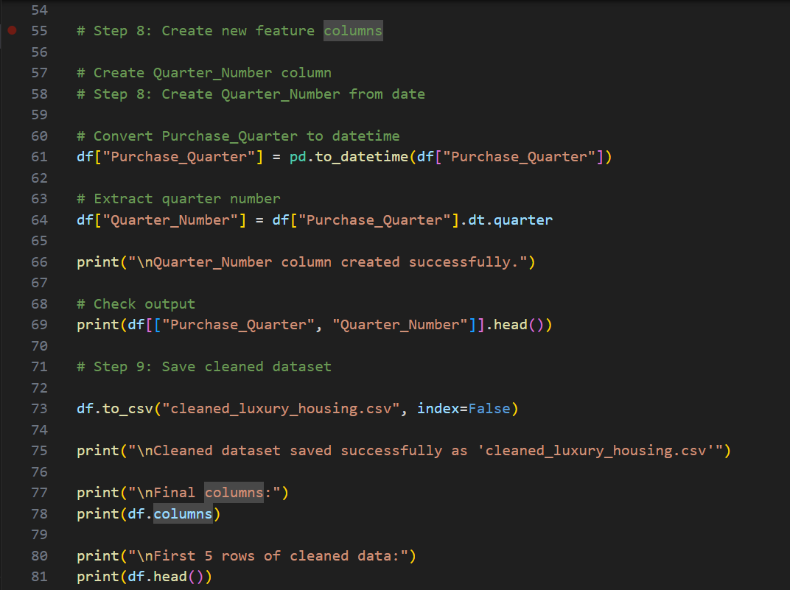

Slide 7
SQL Database Implementation
SQL was used to store and manage structured data.
Tasks Performed:
• Created database tables
• Designed table schema
• Inserted cleaned data
• Validated data integrity
• Performed aggregation queries

Slide 8

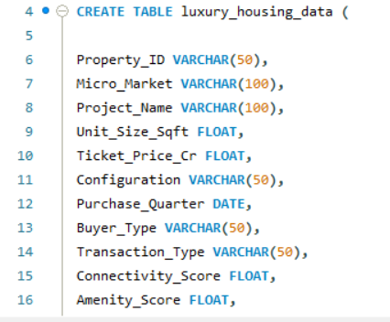
SQL QUERIES
After loading cleaned data from python to SQL database. Here I created database tables, designed table schema and after validating the data integrity , I have performed aggregation queries with the cleaned data.

Slide 9
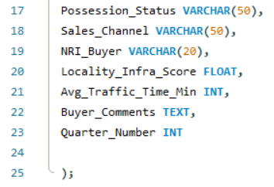
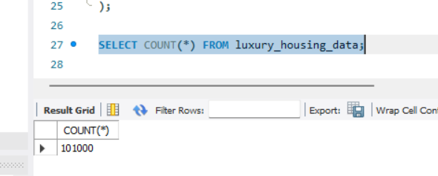
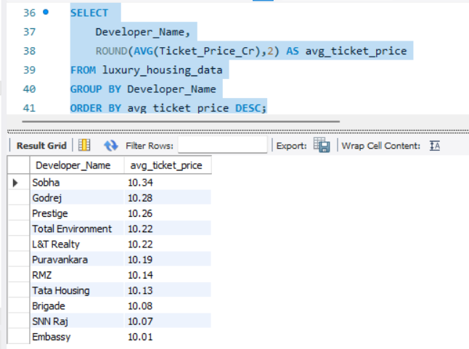
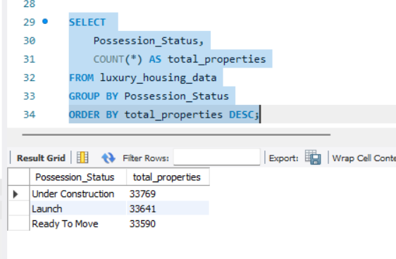

Slide 10
Key Dashboard Visuals
The dashboard includes:
• Market Trends Analysis
• Builder Performance Analysis
• Configuration Demand
• Booking Conversion Analysis
• Sales Channel Efficiency
• Geographical Insights
• Top Performers Dashboard

Slide 11
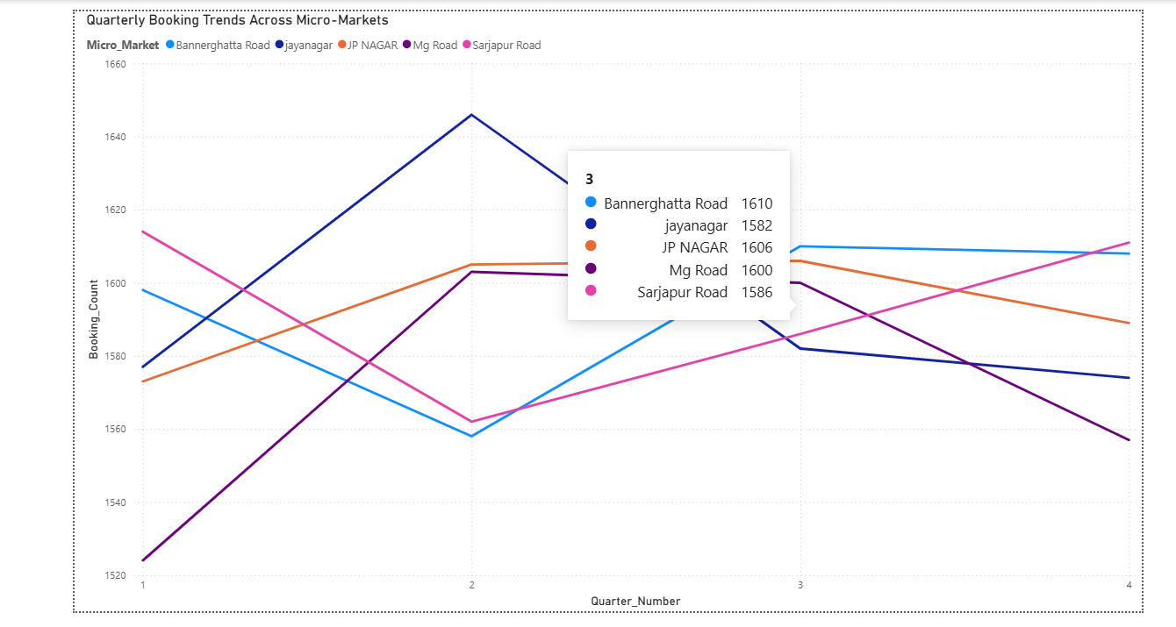
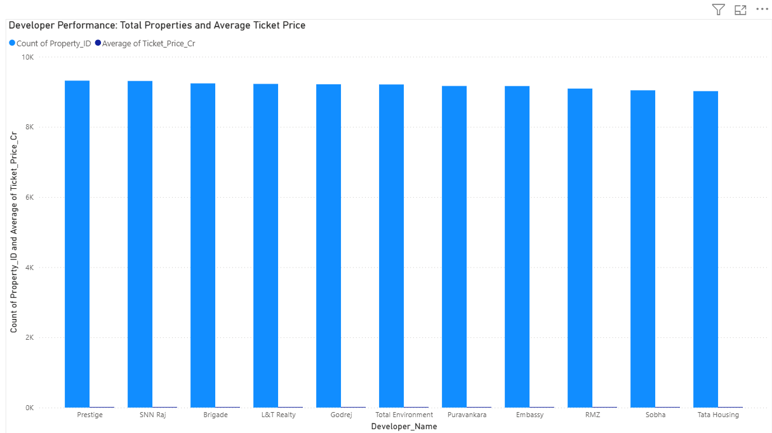
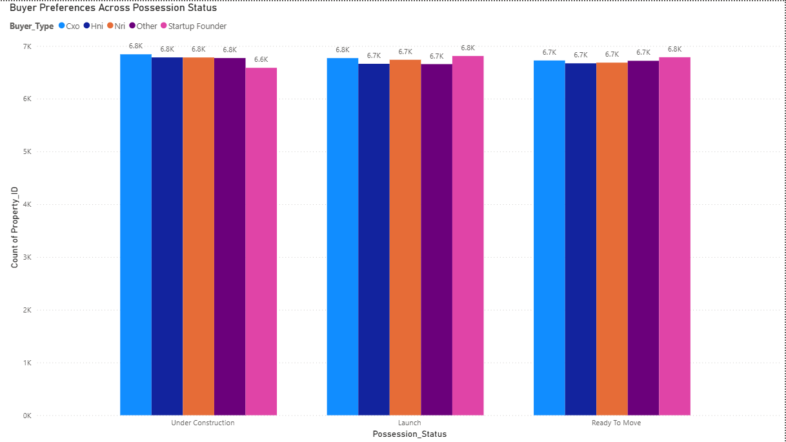
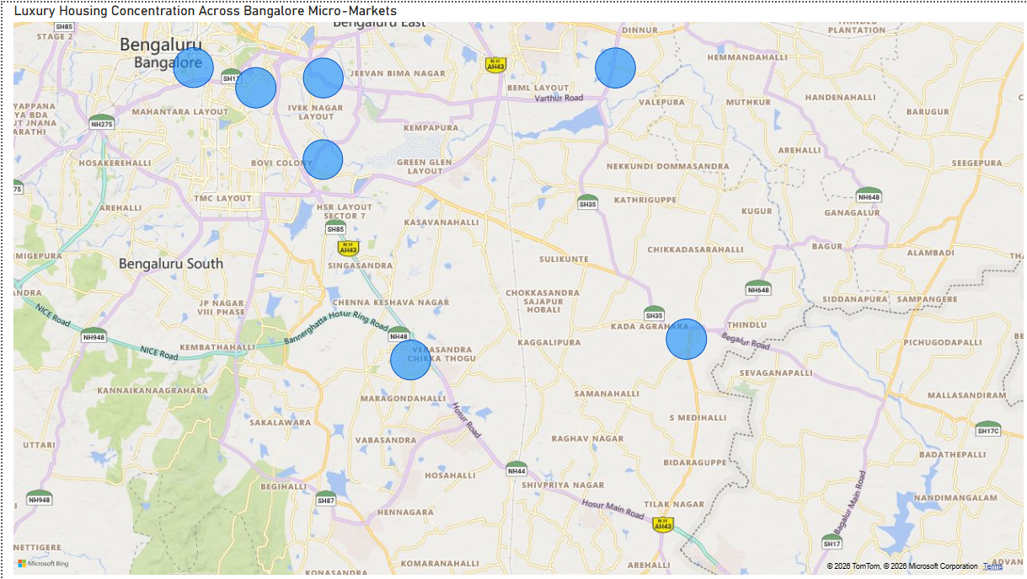

Slide 12
Key Business Insights
• 3BHK configuration is the most preferred housing type
• Some builders dominate the market with higher revenue
• Certain micro-markets show higher booking demand
• Ready-to-move properties attract more buyers
• Specific sales channels generate more bookings

Slide 13
Challenges and Solutions
CHALLENGES
Handling Missing Values
Designing correct Visualizations
Applying filters correctly.
SOLUTIONS
Cleaned data Carefully
Tested Multiple visuals
Verified data accuracy step by step.

Slide 14
Project Conclusion
This project successfully analyzed luxury housing data
to generate meaningful insights.
The dashboard helps:
• Identify top-performing builders
• Understand buyer preferences
• Detect high-demand locations
• Support business decision-making

